Slide 1

Multipurpose Autonomous Farming Vehicle
Under the guidance of
Asst. Prof. Nidhishree
Computer Science Department
Dayananda Sagar College of Engineering.
Vedansh Khandelwal [1DS19CS186]
Nihar Raviprakash [1DS18CS078]
Siddhant Sharma [1DS15CS106]
Yadukrishna [1DS19CS194]
Department of Computer Science & Engineering, DSCE

Slide 2
INTRODUCTION TO THE PROBLEM:
As agriculture grows in size, together with the size of the equipment used on them, there is a need for ways to automate processes, previously performed by the farmer himself, such as sowing, fertilizer spraying, controlling the fields for pests etc. These tasks are perfectly suited for autonomous robots, as they often require numerous repetitions over a period of time and over a large area. The use of robots is a rather new development as most of the existing solutions for automatic supervision, is designed for standard farm equipment, such as tractors, combine harvester and pesticide sprayers. When activities like crop monitoring and mapping of fields or precision spraying of pesticides, a smaller robot is ideal, as it is gentler on the crops and to the ground. This is due to the lower weight compared to a tractor, causing much lesser soil compaction. The degree of soil compaction is important to consider, especially when dealing with monitoring and mapping as this is often performed multiple times throughout the year, as soil compaction can cause a number of problems, such as reduced crop growth and denitrification.
Department of Computer Science & Engineering, DSCE

Slide 3
INTRODUCTION TO THE PROBLEM:
A Multipurpose Autonomous Farming Vehicle is an electric agricultural vehicle designed to carry various agricultural process like seed sowing, irrigation, crop growth monitoring and fertilizing. The vehicle is designed to carry out these operations with least intervention of a human being. First the agriculture land is mapped and distance between each plant is set. Then the vehicle is made to run in predefined path with the help of GPS. After sowing is done the vehicle is made to run in field at regular intervals to monitor the crop from seed to a fully-grown plant. Each plant is individually fertilized whenever necessary, thus preventing the excessive usage of fertilizers as well as wastage of fertilizers.
Currently, there are many challenges faced by the farming, not least of which are a reduction in the available workforce, and a more systematic style of farming. Such factors demand an increase in farming efficiency and productivity. In this work, the autonomous farm is seen as a complex system, where there is necessarily a seamless integration of requirements, bringing together the areas of robotics for autonomous farming, and Precision Agriculture, which deals with issues of agronomy.
There is urgent need to mechanize the agricultural operations so that wastage of labour force is avoided and farming is made convenient and efficient.
Department of Computer Science & Engineering, DSCE

Slide 4
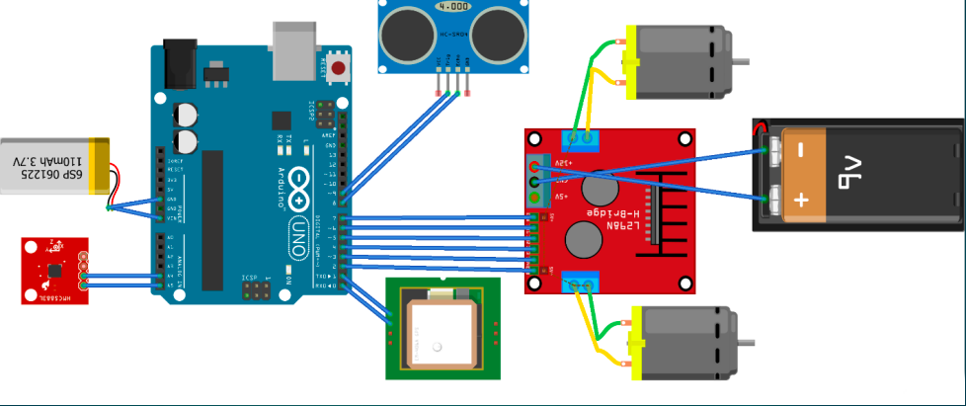
SYSTEM DIAGRAM / ARCHITECTURE:
Department of Computer Science & Engineering, DSCE

Slide 5
Modules
All the working modules like the assembly & gear module & dispenser module & watering module
Typical equipment and components on farming vehicle: • Plough • Seed sowing mechanism • Seed carrier • Pesticide carrier • electrical motor • Battery

Slide 6
Modules Descriptions
Plough Module: The plough module draws over soil to turn it over and cut furrows in preparation for the planting of seeds
Seed Sower: mechanism for sowing seeds having a seed supply device which is carried by a sowing frame
Seed Carrier: Is a component that carries seeds
Pesticide/Water Carrier: Is a component that carries pesticide
Electrical Motor and Battery: Works together to make farming vehicle functional

Slide 7
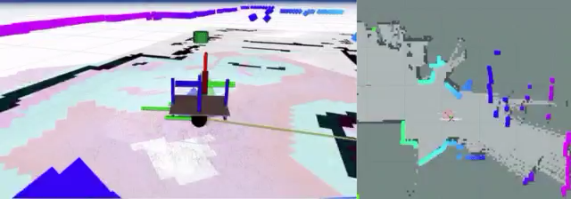
INPUT:
The program takes waypoints from the point that we provide on the map. The waypoints can be downloaded and then fed into the microcontroller using Wi-Fi module
Department of Computer Science & Engineering, DSCE

Slide 8
PREPROCESSING:
The preprocessing steps specifically for developing an autonomous agricultural robot system:
Image and sensor data collection: Collecting data from sensors and cameras is crucial for the development of an autonomous agricultural robot. The data should be collected from multiple sources and should include information about soil conditions, crop growth, weather conditions, and other factors that affect agricultural production.
Image and sensor data cleaning: Raw data collected from sensors and cameras may contain errors or inconsistencies that need to be corrected. This can involve removing noise, filling in missing data, and correcting errors.
Image and sensor data normalization: The data collected from sensors and cameras may need to be normalized to ensure that it is consistent and comparable across different sources. This can involve scaling data to a common range, converting units, and standardizing data formats.
Department of Computer Science & Engineering, DSCE

Slide 9
PREPROCESSING:
Feature extraction: Extracting features from the image and sensor data is an important preprocessing step for developing an autonomous agricultural robot. This involves selecting and creating features that are relevant to the task at hand, such as plant type, plant height, and soil moisture.
Training data generation: Once the relevant features have been extracted, the data needs to be labeled and categorized. This involves manually labeling the data with the appropriate tags, such as plant type, plant height, and soil moisture.
Machine learning model training: Once the training data has been generated, it can be used to train machine learning models. These models can then be used to make predictions and decisions about tasks such as planting, weeding, watering, harvesting, and crop monitoring.
Department of Computer Science & Engineering, DSCE

Slide 10
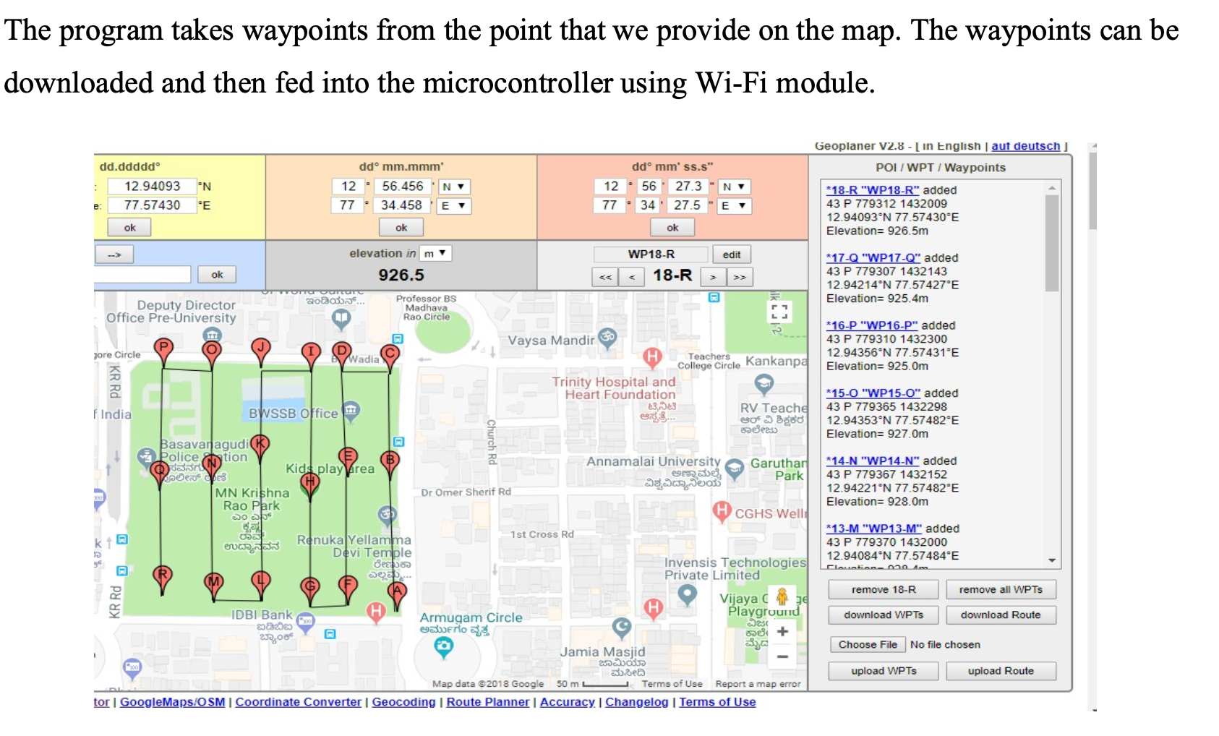
ALGORITHM:

Slide 11
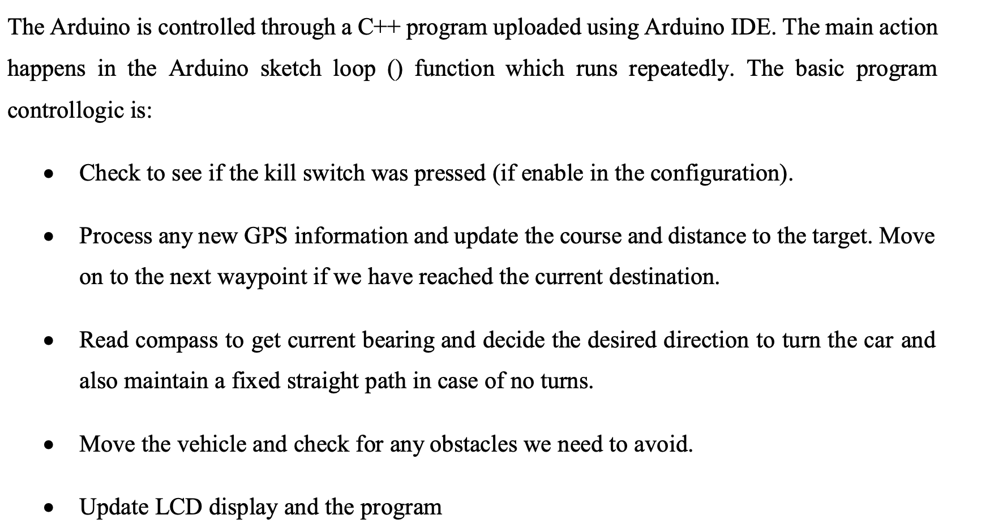
ALGORITHM:
Department of Computer Science & Engineering, DSCE

Slide 12
ALGORITHM :
Creating Transform
Creating Map
Drive around and map
Set initial starting location
Start autonomous navigation

Slide 13
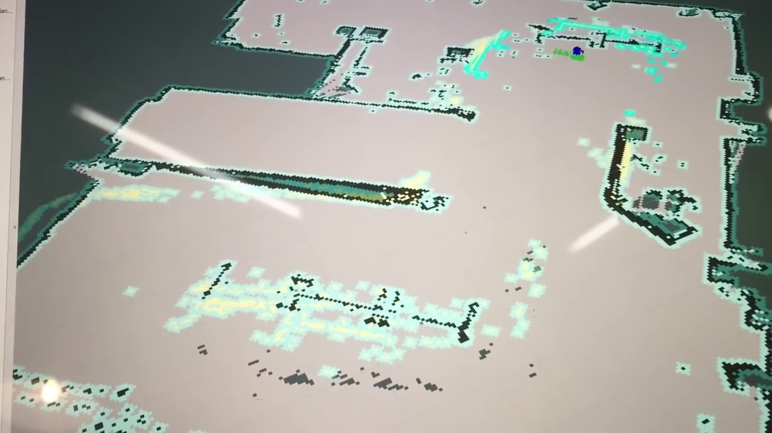
OUTPUT:
Department of Computer Science & Engineering, DSCE

Slide 14
GUI DESIGN:
We have developed a turtle bot as the GUI of our project.
Department of Computer Science & Engineering, DSCE

Slide 15
GUI DESIGN:
Department of Computer Science & Engineering, DSCE

Slide 16
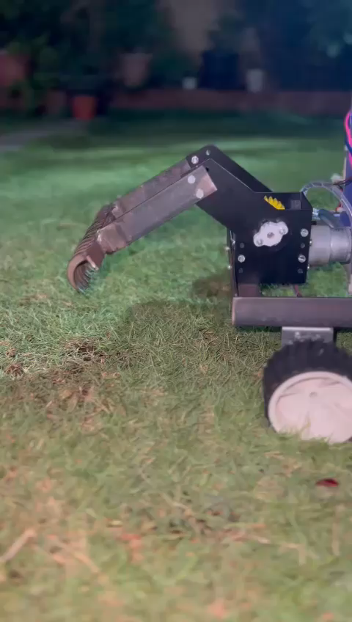

Slide 17
`
THANK YOU!
Department of Computer Science & Engineering, DSCE

